Slide 1
Lecture-31
Mathematics 2 (15B11MA211)
CO [C106.6]
Topic: Cauchy Integral Formula
Reference for the lecture
R.K Jain and S.R.K. Iyenger, “Advanced Engineering Mathematics” fifth edition, Narosa publishing house, 2016.

Slide 2
Topics Covered
Cauchy integral Formula
Proof
Examples

Slide 3
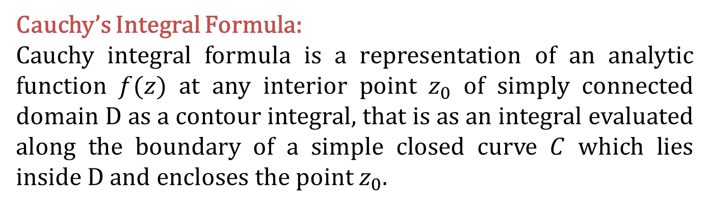

Slide 4
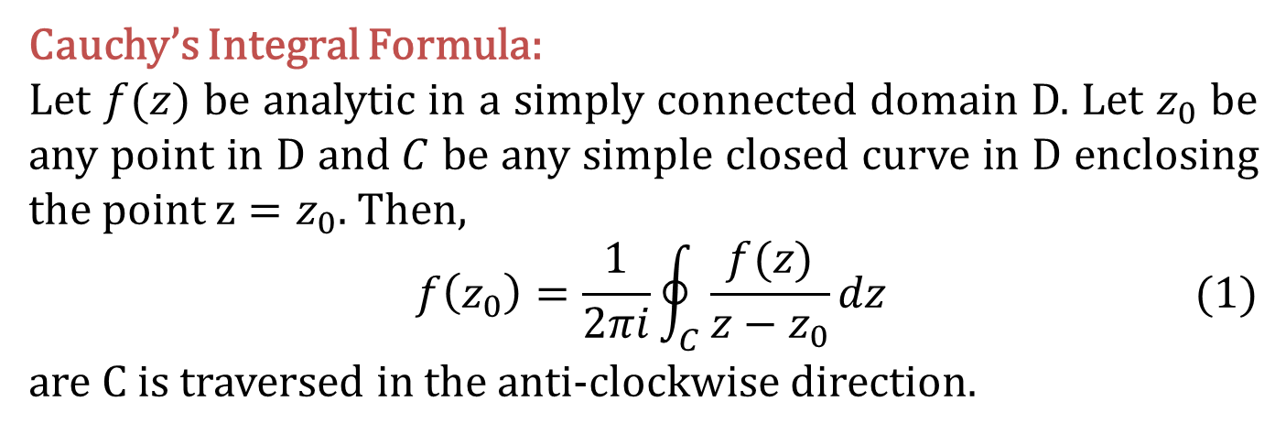
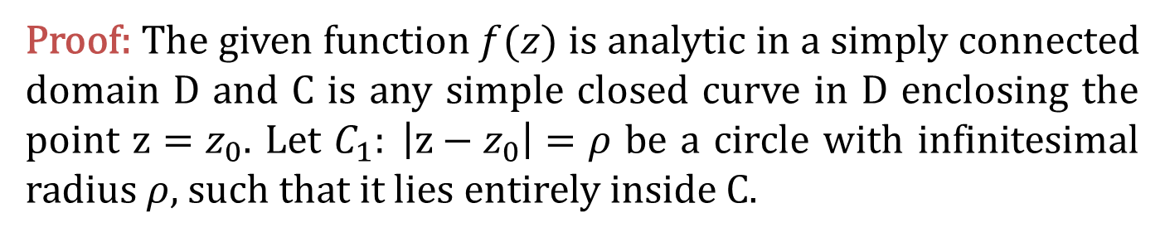
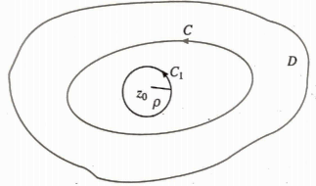

Slide 5
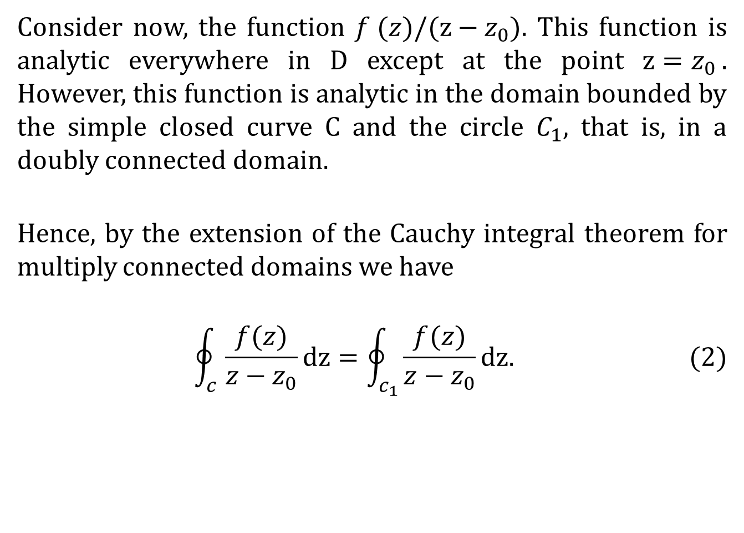

Slide 6
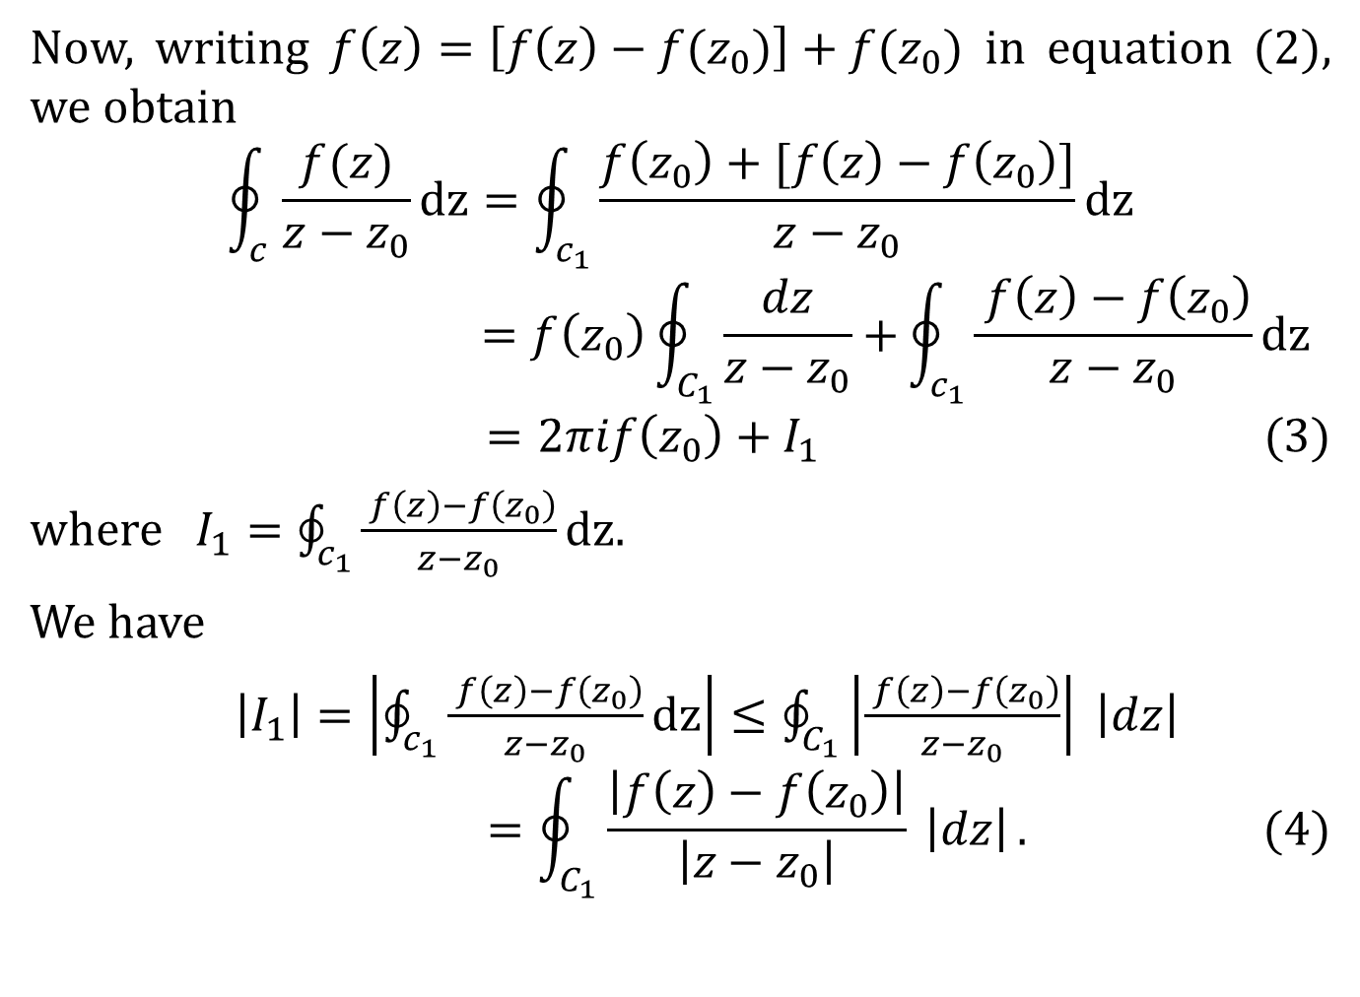

Slide 7
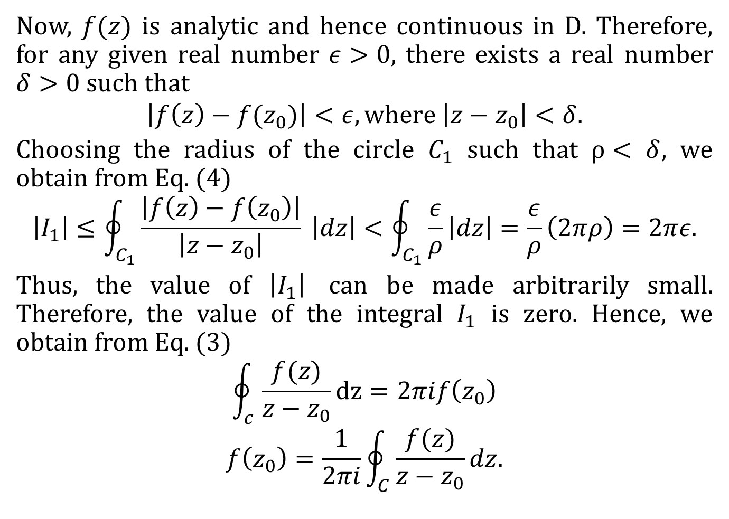

Slide 8
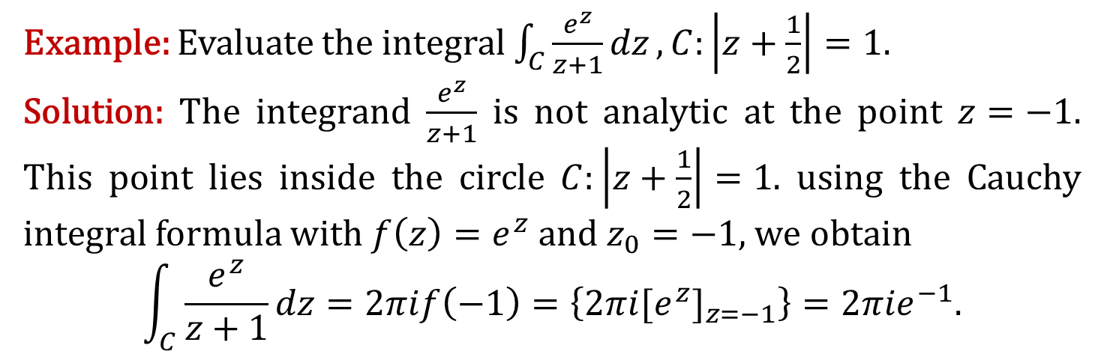

Slide 9
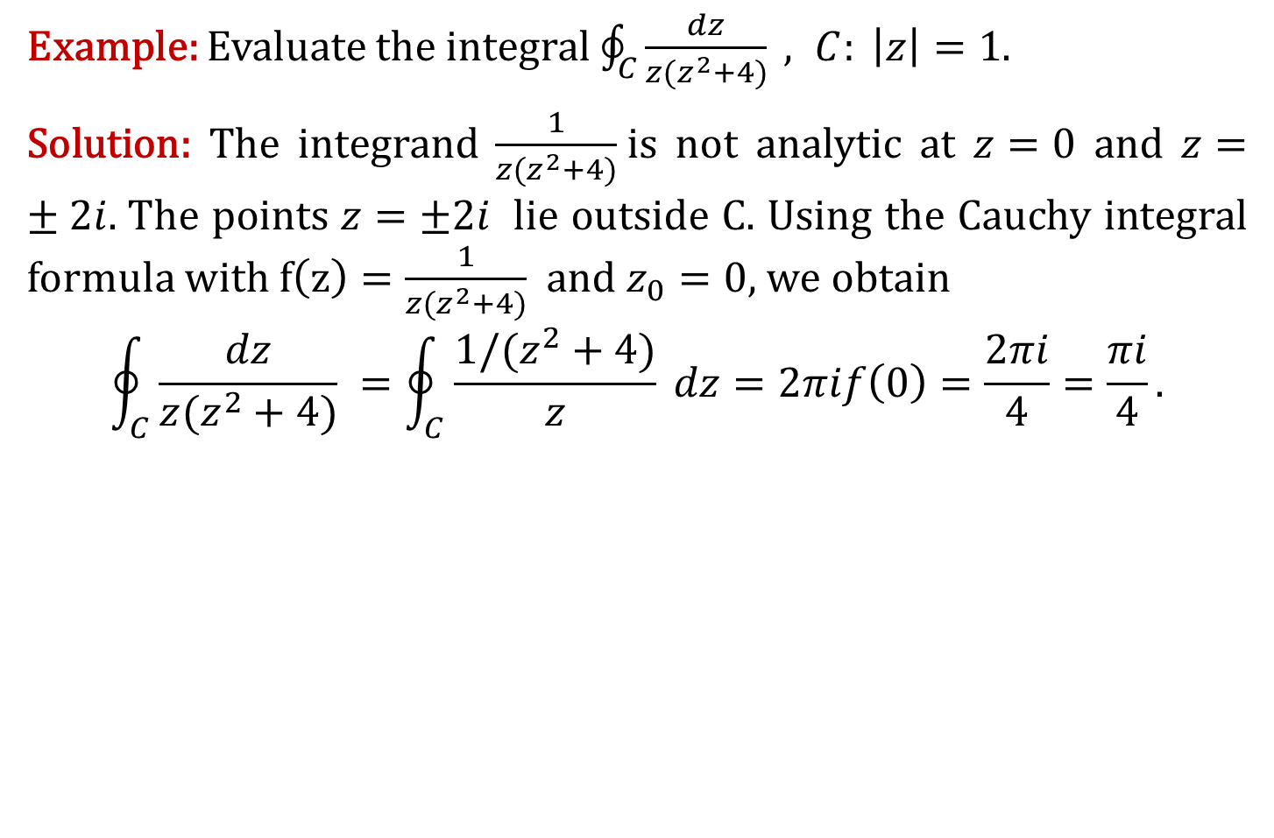

Slide 10
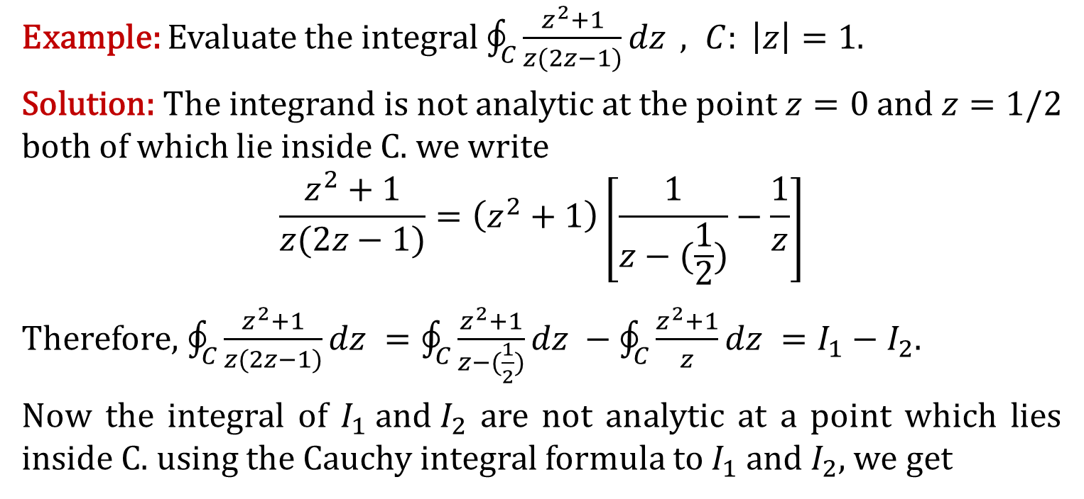

Slide 11
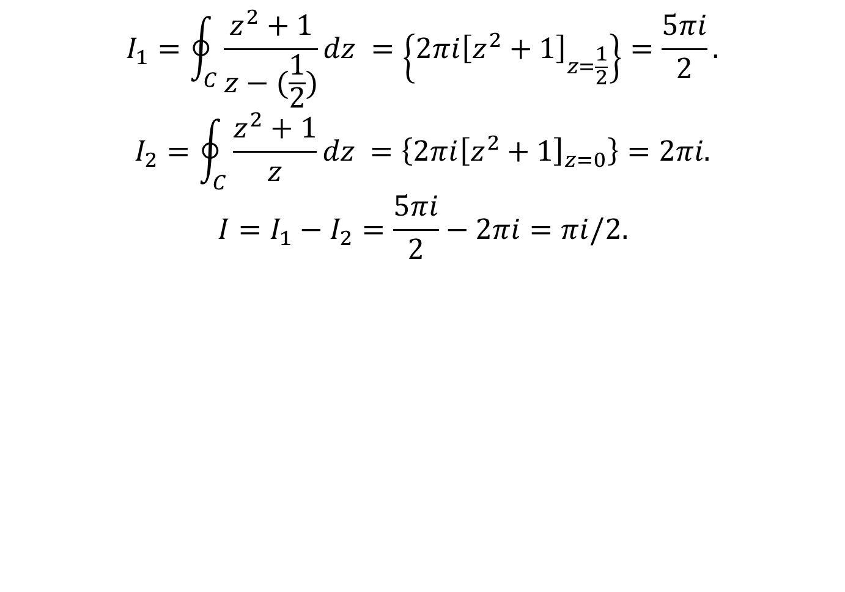

Slide 12
Thank You

